Slide 1

Mycoremediation Solutions:
Revolutionary Fungal Technology for England’s Water Crisis
mycene
Meow-Ludo Meow-Meow & Krish Patel
Pilot Project Proposal: Sustainable Wastewater Treatment using Nature’s Most Powerful Decomposers

Slide 2
England’s Water Crisis: The Urgent Need
Critical Statistics:
60% increase in serious pollution incidents (2024)
2,801 total pollution incidents (highest on record)
Only 14% of rivers achieving “good” status
£24B infrastructure investment needed (2025-2030)
Recent Developments (2025):
Water (Special Measures) Act 2024
Environment Agency: “Intolerable pollution”
15,000 marched on Parliament
AMP8: £20B for wastewater networks

Slide 3
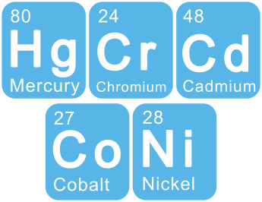
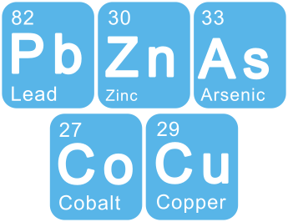







The Science: Mycoremediation Technology
Biosorption
Heavy Metals
Bioaccumulation
Pollutants
Enzymatic
Degradation
Biotransformation
Toxins

Slide 4
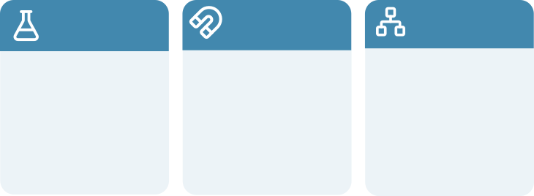
Our Technology:
Three Revolutionary Capabilities
Enzyme
Arsenal
Metal Sequestration
Mycelial Networks
Ligninolytic enzymes break down
complex organics, pharmaceuticals, dyes, and persistent pollutants
Cell wall binding groups capture heavy metals with 90%+ removal efficiency
High surface area filamentous structure for enhanced mass transfer

Slide 5

Proven Success Stories
Global Case Studies Demonstrating Efficacy:
  Oregon Storm Water (2014): Mycofilters reduced waterborne pollutants, validated scientifically
  Tunisian Tannery (2023): 45% COD removal, significant chromium reduction
  Pune Domestic Wastewater (2013): 88.34% BOD reduction, major COD improvements 80-95% 50-70% Zero Carbon
  Scientific Validation: 150+ peer-reviewed studies
90%
Reduction
Carbon Negative
Zero Waste
50-70%
Pollutant Discharge
Process Operation
Toxic Sludge
Cost Savings

Slide 6

Our Innovative Pilot Solution
Integrated Mycoremediation System Design:
Modular Biofilters
Real-Time Monitoring
Circular Economy
Scalable mycelial filter systems with optimised species selection and dimensions
IoT sensors for pollutant removal, fungal health, automated optimisation
Biomass harvesting for biofuel, or carbon credits, converting waste to revenue
Technical Innovation:
Multi-species consortium for broad-spectrum pollutant degradation and species locality
Modular filter system for ease of use and locale specificity
AI-driven adaptive management

Slide 7

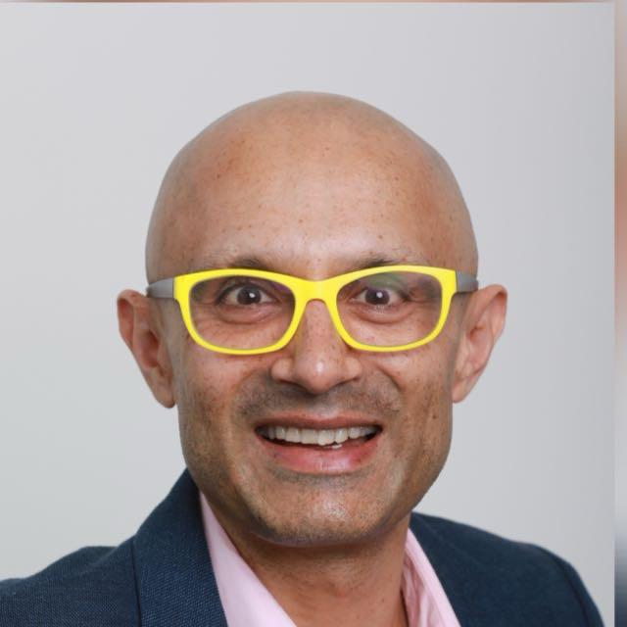
Expert Team
Meow-Ludo Meow-Meow
  BSc Genetics (UNSW)
  MBA (Executive , Curtin)
  5 Australian Patents
  Moth Diagnostics: USD$750K raised
  BioFoundry: Australia’s first DIY biotech
Krish Patel
  BSc Economics (LSE - London)
  25 Years R&D/Innovation
  2 Unicorn-scale ventures
  10 Years Partner: BDO/Grant Thornton AU
  UK Based, local market expertise

Slide 8
Pilot Implementation Roadmap
18-Month Plan:
Phase 1 (Months 1-3): Lab Optimisation
  Isolate optimal fungal strains
  Optimise growth conditions
  Preliminary pollutant removal studies
Phase 2 (Months 4-6): Pilot Plant Design
  Engineer modular bioreactor systems
  Install monitoring systems
  Partnership with water authority/Local Unis
Phase 3 (Months 7-12): Field Trials
  Process real wastewater
  Optimise operational parameters
Future (2026-2029):
PFAS filtering and treatment
Mining tailings
Expanding species & strains
Mass/Scale Production
Further investment and increasing staff

Slide 9
Investment Requirements &
Expected Impact
Funding Requirements:
  £250,000: Equipment & infrastructure
  £180,000: Personnel (18 months)
  £70,000: Materials & consumables
  £50,000: Regulatory & compliance
  £50,000: Contingency
Market Opportunity:
  UK: £24B investment committed
  50-70% cost reduction
  Carbon credit revenue
  Byproduct value: biofuels
  Global export potential

Slide 10
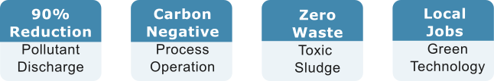
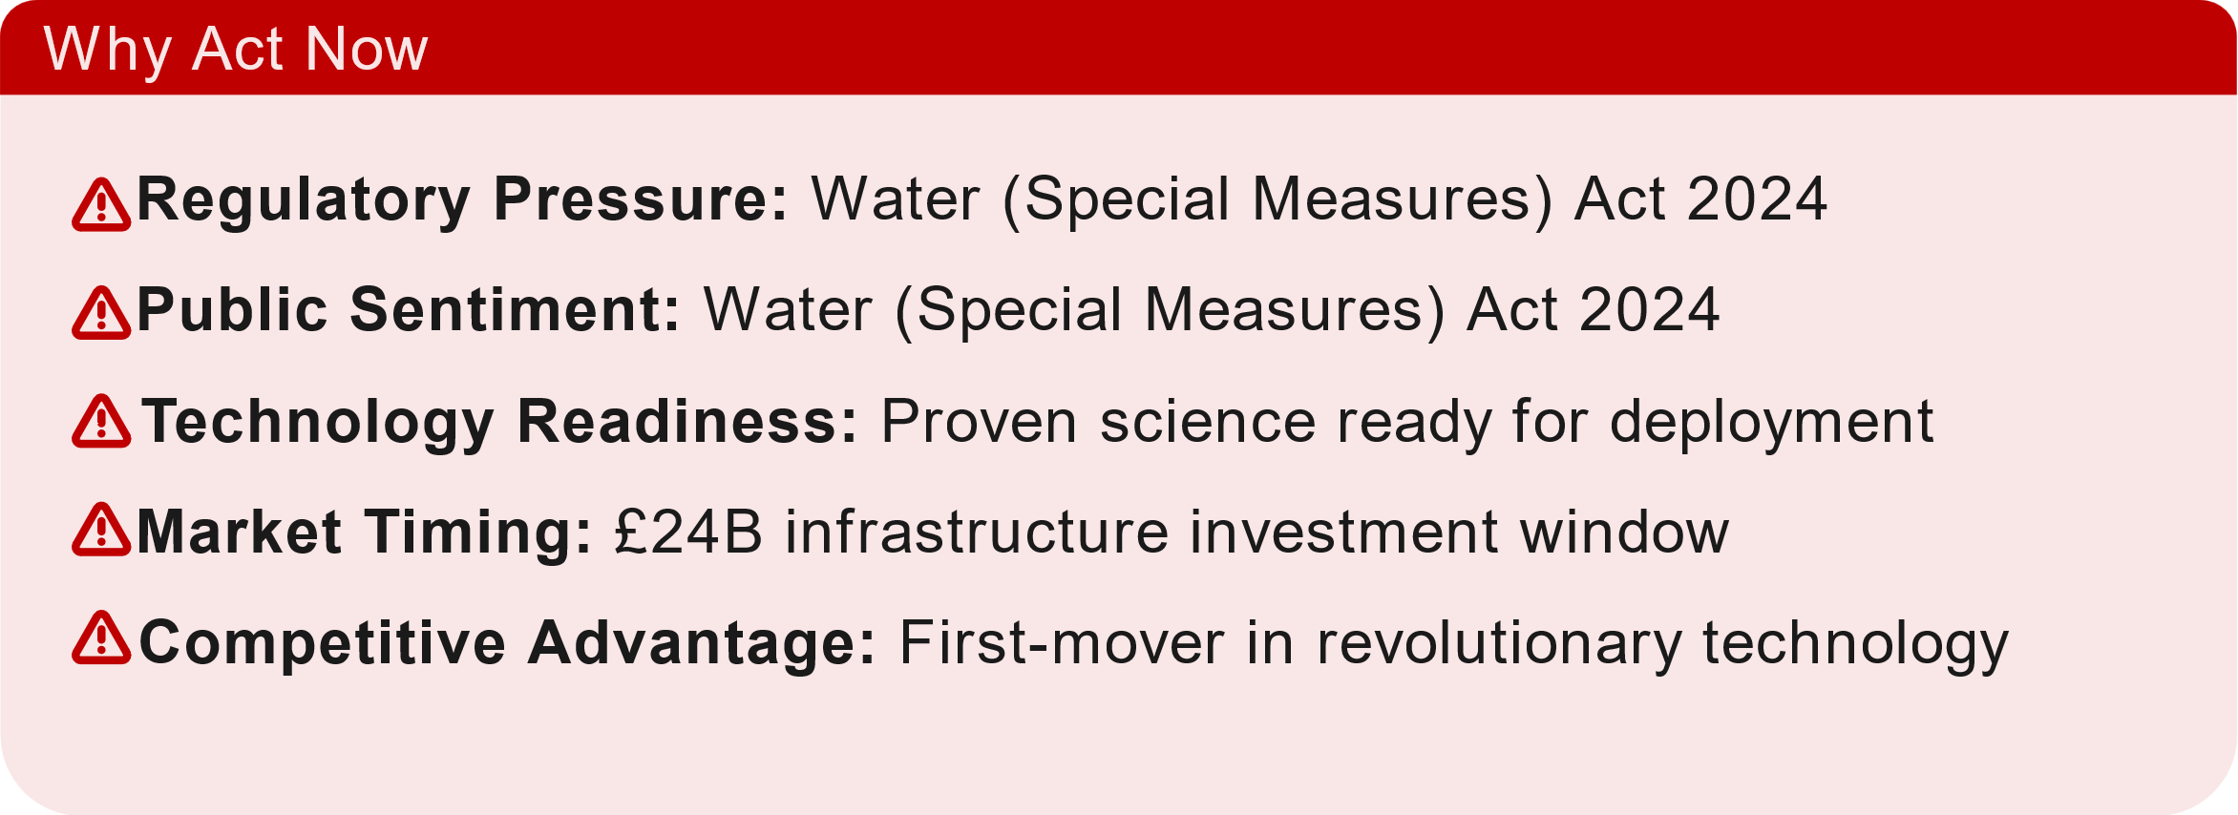
Environmental & Social Impact

Slide 11

Call to Action
England’s water crisis demands immediate, innovative action.
Mycoremediation offers a proven, scalable, sustainable solution.
What We’re Seeking:
Investment
Industry Partner
Regulatory
£600K seed funding for 18-month pilot
Water company
& Uni for pilot
deployment
Environment Agency engagement

Slide 12

Thank You
Let’s Transform England’s Water Future Together
www.mycene.io

